Slide 1

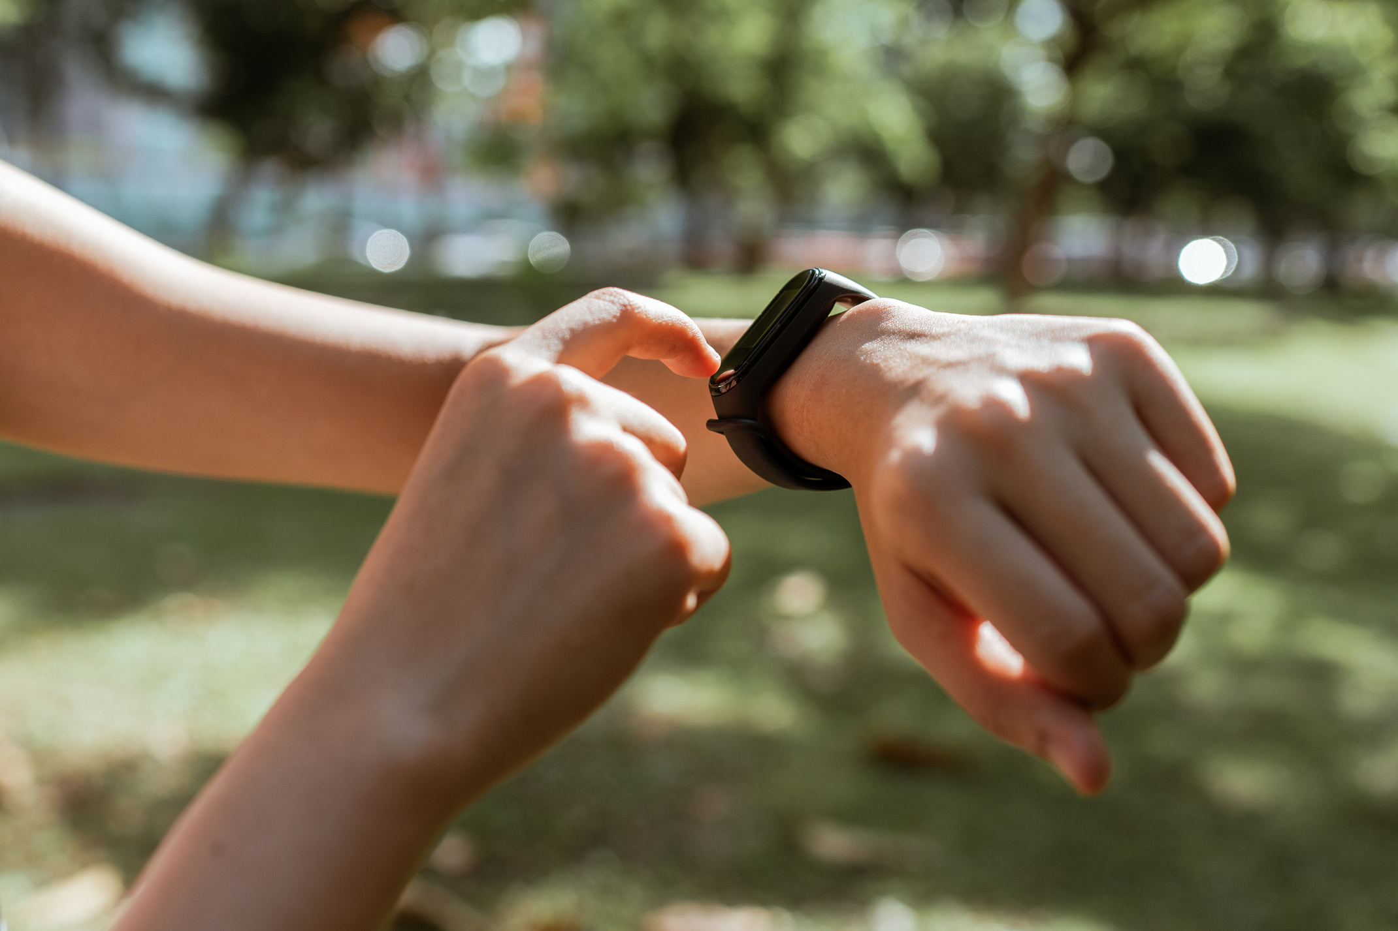


Smart Wearable & IoT Security
Securing the Future of Connected Devices
Presented By:
Mahamadali Kadiwal

Slide 2

Introduction to Smart Wearables
Smart wearables are electronic devices worn on the body that connect to the internet or other devices.
Examples: Smartwatches, fitness trackers, smart glasses, health monitors, and AR/VR headsets.
These devices collect, process, and share user data in real time.

Slide 3

What is IoT (Internet of Things)?
IoT refers to a network of interconnected devices that communicate and exchange data through the internet.
Components
01
Sensors
02
Connectivity
(Wi-Fi, Bluetooth, LTE)
03
Data processing
04
User interface
Example: Smart home systems, connected cars, industrial IoT, and wearable tech.

Slide 4
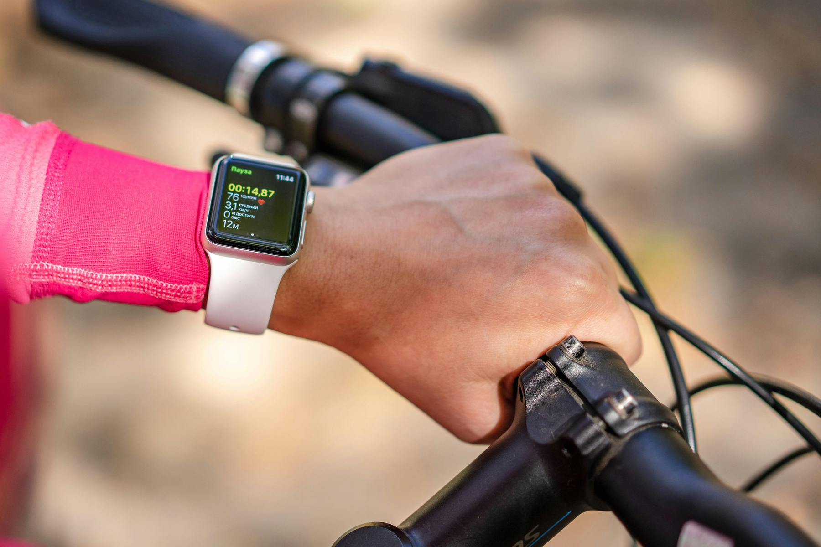

How Smart Wearables Use IoT
Data Collection: Sensors capture heart rate, movement, temperature, etc.
Communication: Devices sync with smartphones or cloud servers.
Analytics: AI/ML algorithms process user data for insights.
Feedback: Results shown via apps or notifications.

Slide 5
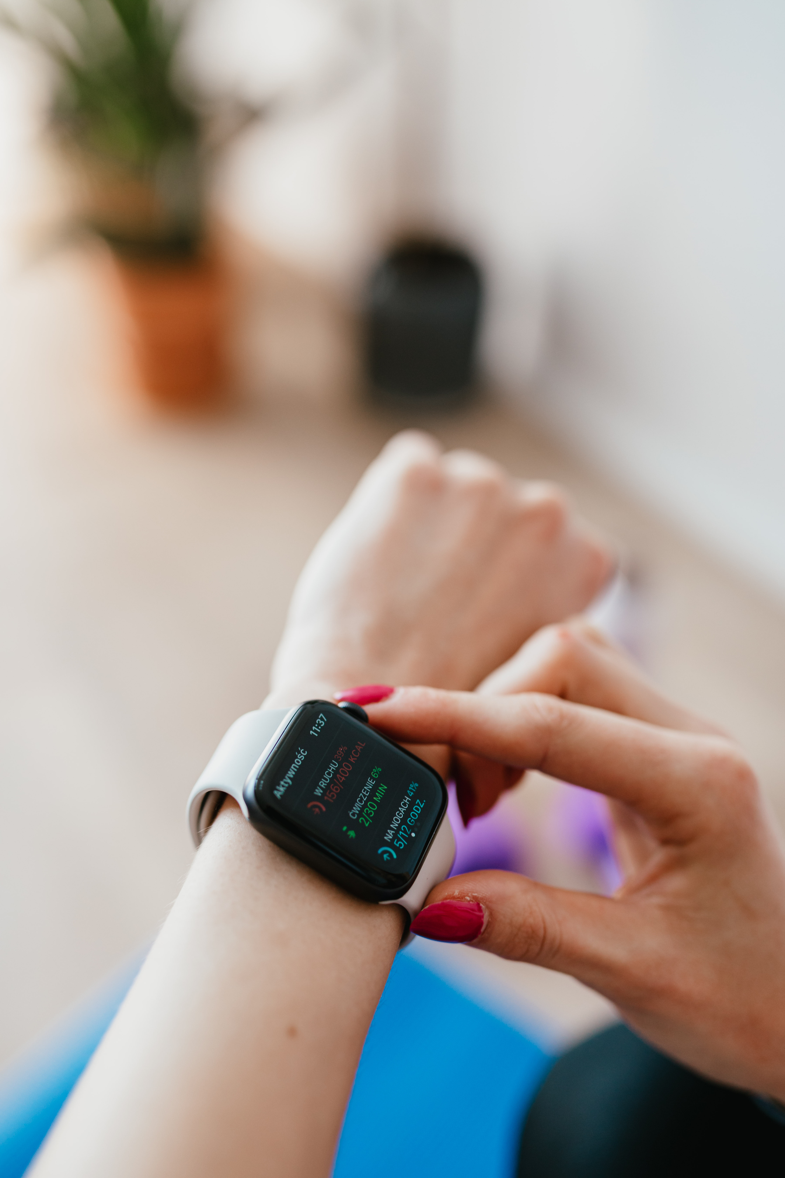

Security Challenges in Smart Wearables
01
02
03
04
Data Privacy Risks
Weak Authentication
Unsecured Communication
Third-party App Risks

Slide 6

Common IoT Security Threats
Man-in-the-Middle (MITM) Attacks: Intercepting data between wearable and smartphone.
Data Breaches: Unauthorized access to cloud-stored health or biometric data.
Malware Injections: Attackers installing malicious firmware updates.
Denial-of-Service (DoS): Flooding IoT devices with traffic to disrupt service.
Physical Tampering: Accessing devices directly to extract stored data.

Slide 7


Security Solutions & Best Practices
01
End-to-End Encryption: Secure data in transit and at rest.
02
Regular Firmware Updates: Patch vulnerabilities promptly.
03
Strong Authentication: Use biometrics or multi-factor authentication.
04
Secure APIs: Prevent unauthorized data access.
05
Data Minimization: Collect only necessary user data.
“Security has to be built in — not added later.”
06
User Awareness: Educate users about security settings and risks.

Slide 8
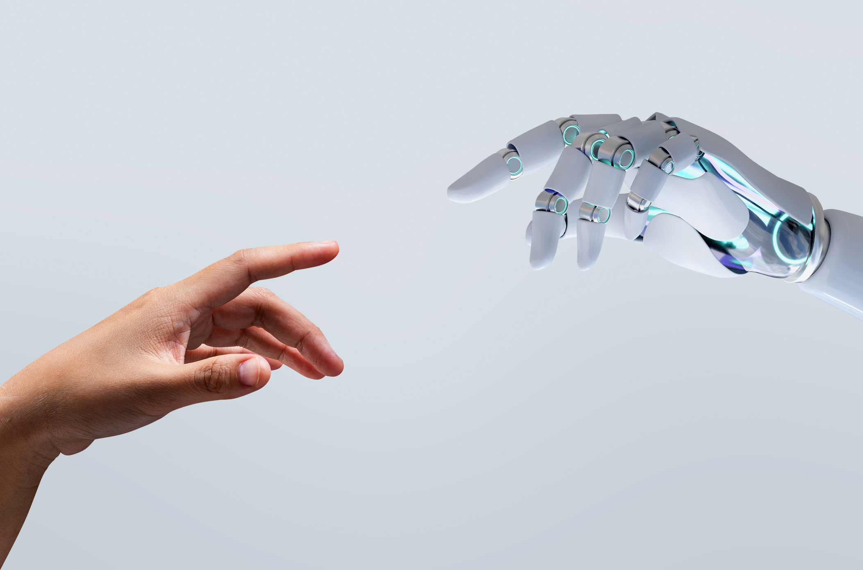
Role of AI & Blockchain in IoT Security
01
AI in Security:
Detects abnormal device behavior and intrusion attempts.
Predictive analytics for threat detection.
02
Blockchain:
Provides decentralized and tamper-proof record of device transactions.
Improves authentication and data integrity.

Slide 9
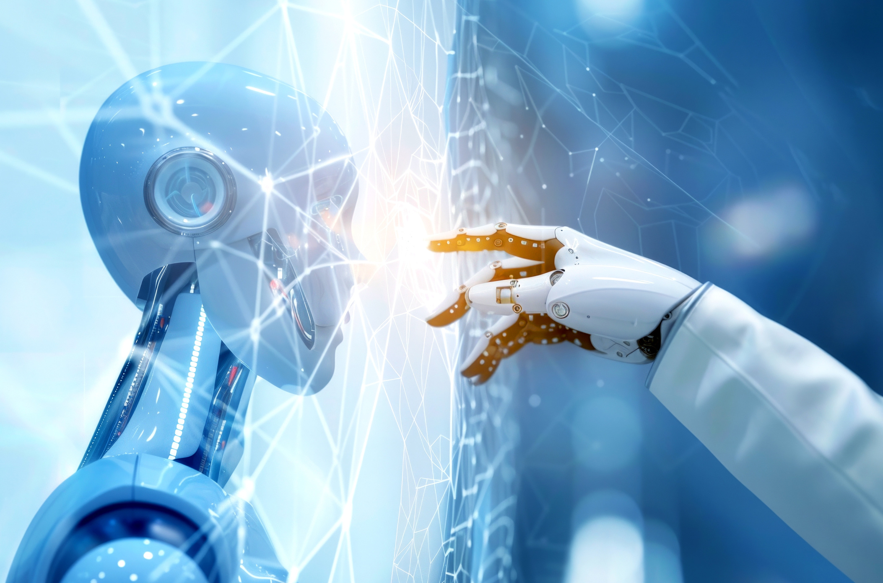

Future of Wearable & IoT Security
01
Adoption of Zero-Trust Architecture.
02
More regulatory compliance (GDPR, DPDP, ISO/IEC 27001).
03
Hardware-level encryption becoming standard.
04
Edge computing for localized data processing to reduce exposure.
05
User control & transparency as a key focus.

Slide 10

Conclusion
01
Smart wearables and IoT devices are shaping the connected world.
02
Security must evolve along with technology to protect user data and trust.
03
Collaboration between developers, manufacturers, and users is essential.
04
Key Takeaway: “A smarter world must also be a safer world.”

Slide 11



Thank You
Very Much!

